Slide 1
Space Computers
Łukasz Machnik

Slide 2
Space flights

Slide 3
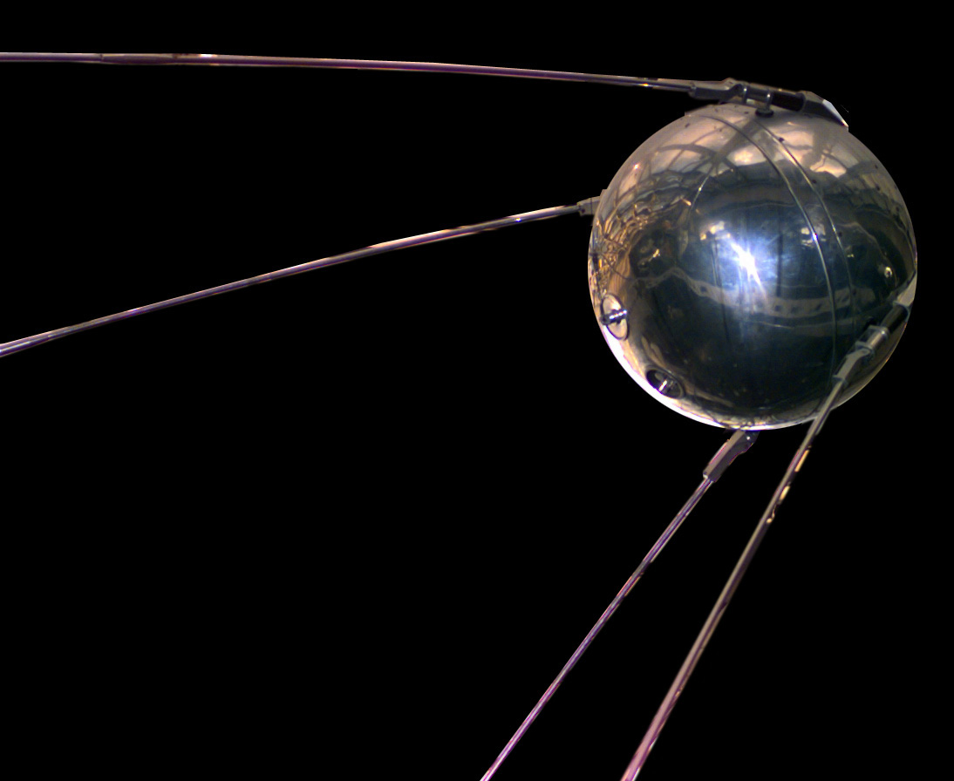
Beginnings
First unmanned space flights used sequencers - devices that stored a list of commands and the time they should be executed

Slide 4
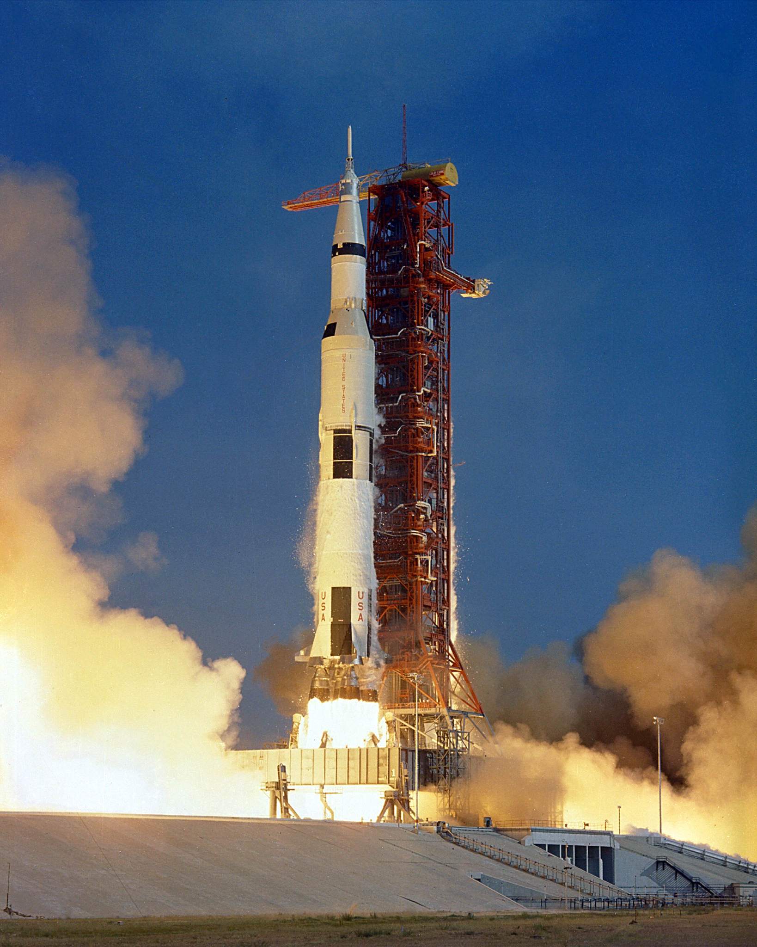
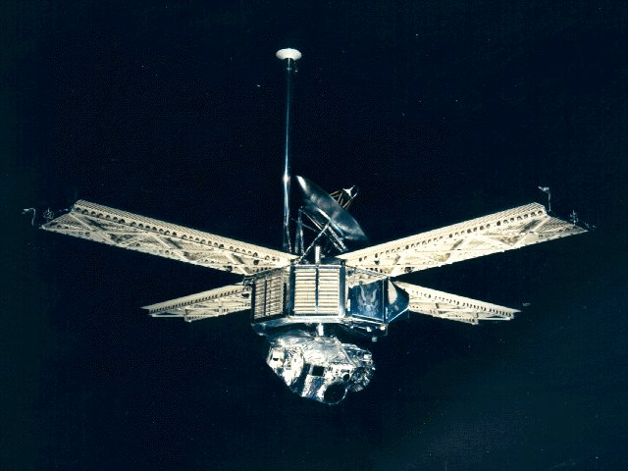
Mariner 6 and 7,
Saturn V
Mariner 6, Mariner 7 and Saturn V were the first space vehicles to use a computer.
Notes:
Mariners’ computer weighted about 12 kg
Saturn V’s computer weighted about 2 kg

Slide 5
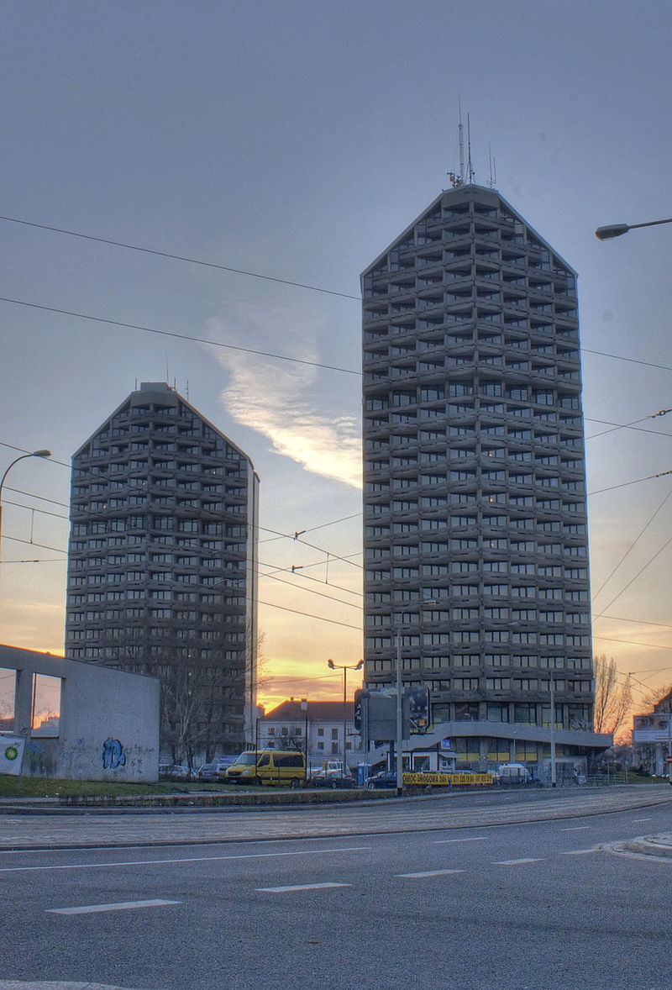
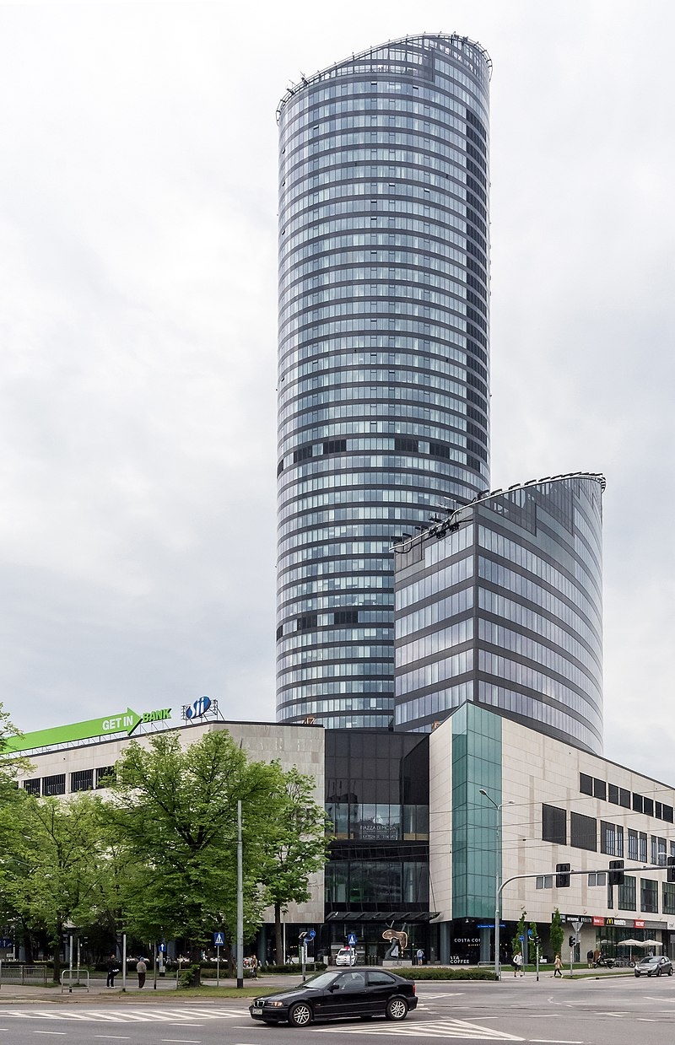
Notes:
Saturn V was about 30 meters higher than “Kredka” (the higher of this two) or about half of Sky Tower’s height.

Slide 6
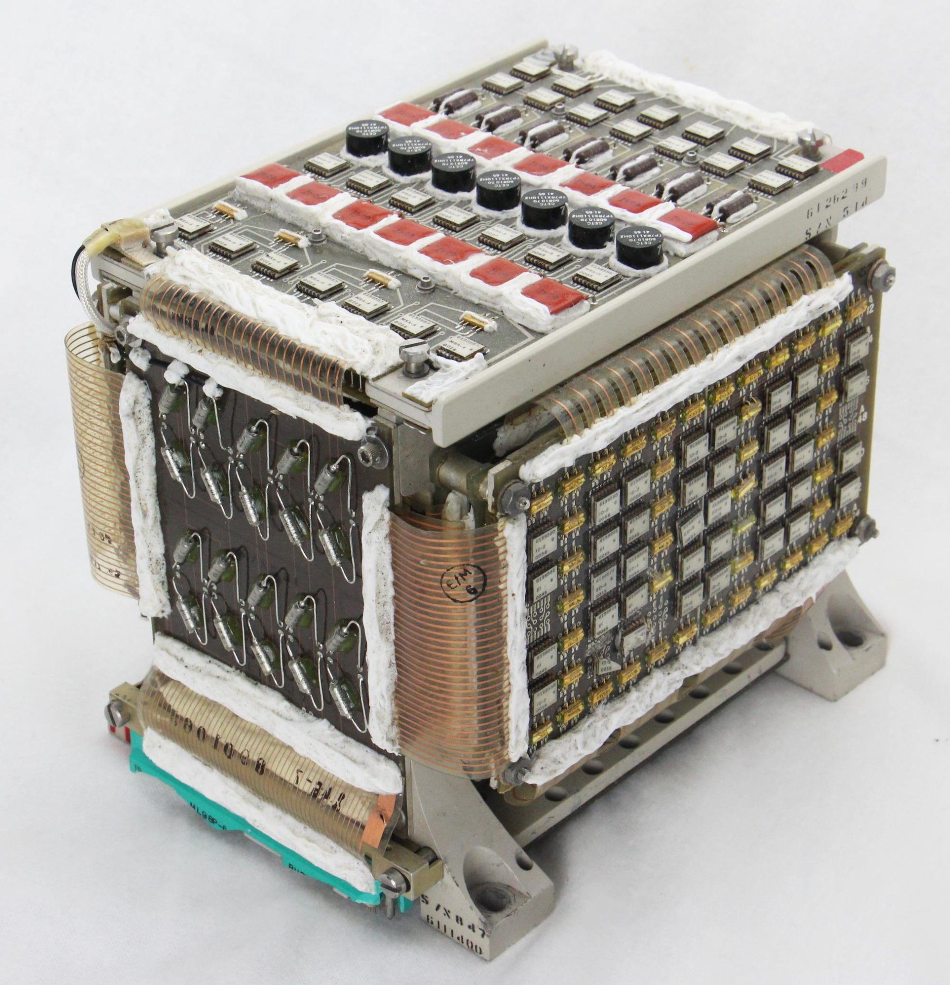
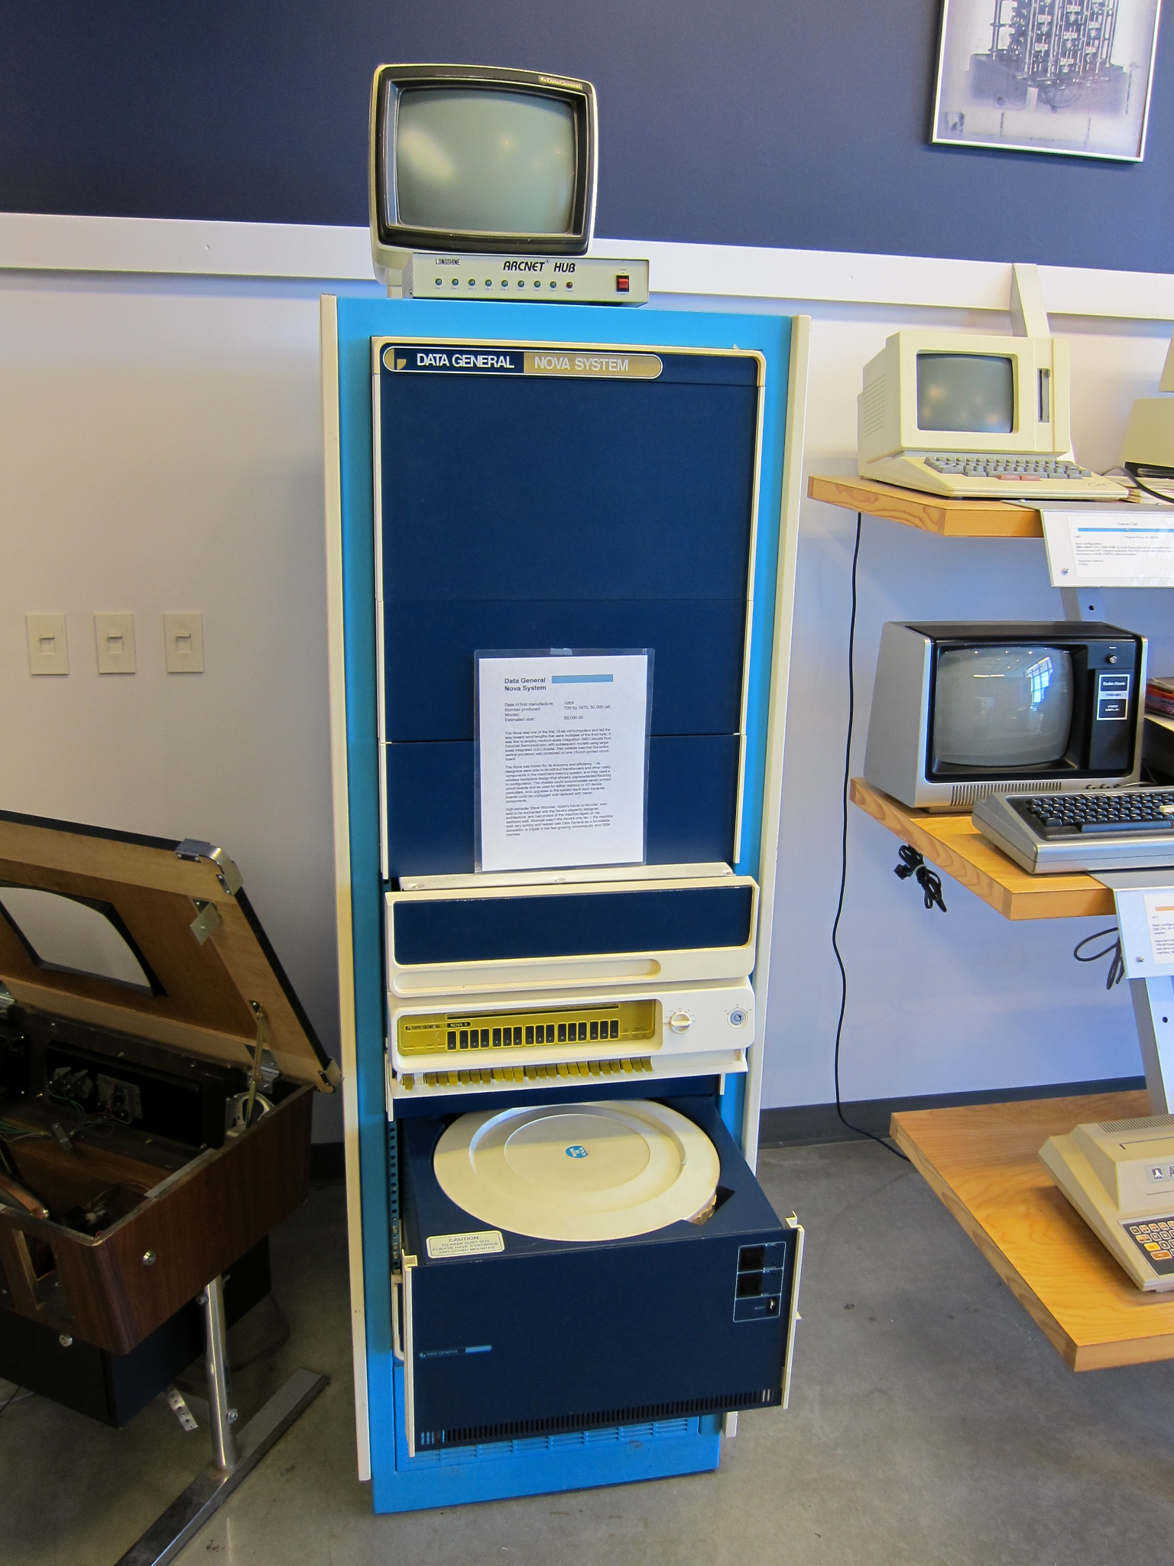
Notes:
Computers back then were pretty big - maybe not the size of a room (as the first computers were) but the size of a big fridge.

Slide 7
Black hole image

Slide 8
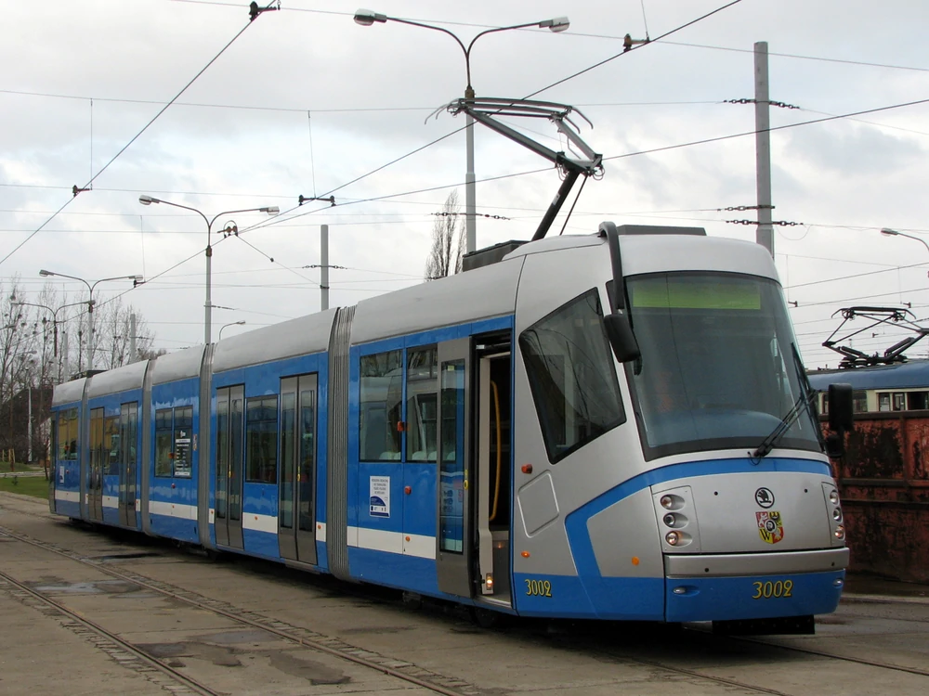
What can we see?
Black hole in the center of Messier 87
Black hole is 6.5 billion times the mass of the Sun
Notes:
Messier 87 - one of the biggest galaxies we know, 53.49 million light years away.
If The Sun was the mass of an ant, this black hole would be the mass of this Skoda tram

Slide 9
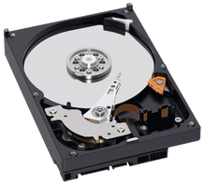
How was it made?
Eight ground-based radio telescopes configured to work like one radio telescope the size of the Earth
Radio telescopes in total gathered 5 PB of data
Hard drives with data were collected in analytics center
Using cloud and special algorithms to analyze the data and create the image
Notes:
1 PB = 1000 TB = 0.5 t hard drives
Hard drives had to be moved physically because internet infrastructure wouldn’t be able to handle this much data.
In analytics center data was reduced - only data interesting for scientists was kept - it reduced data size from PB to TB.

Slide 10
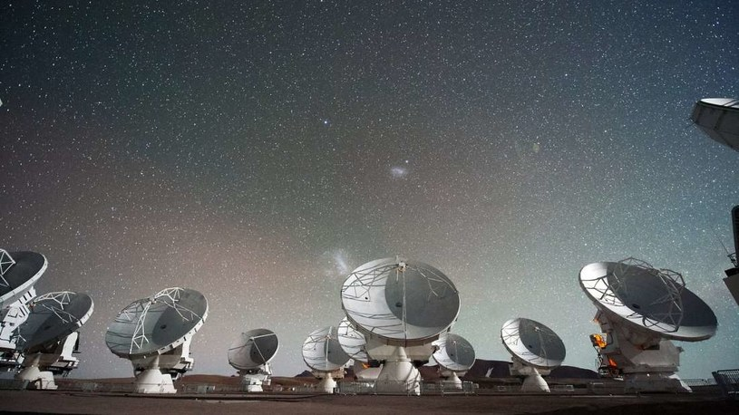

Slide 11
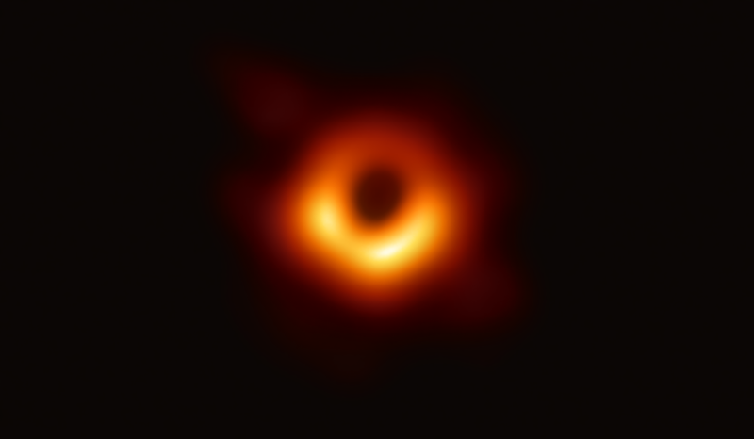

Slide 12
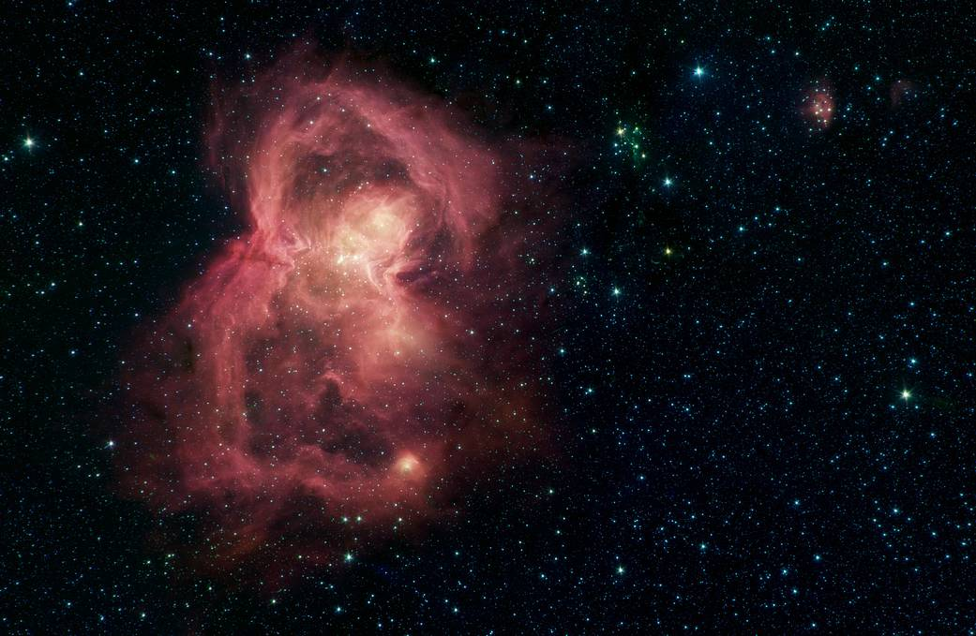
Notes:
“Space butterfly” - nursery for stars

Slide 13
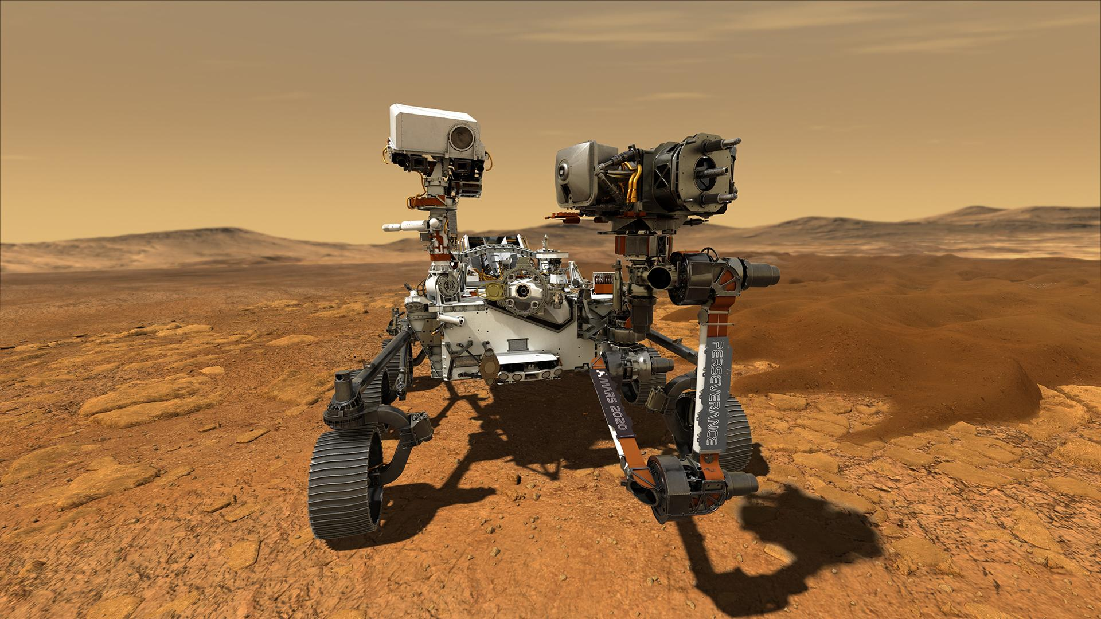
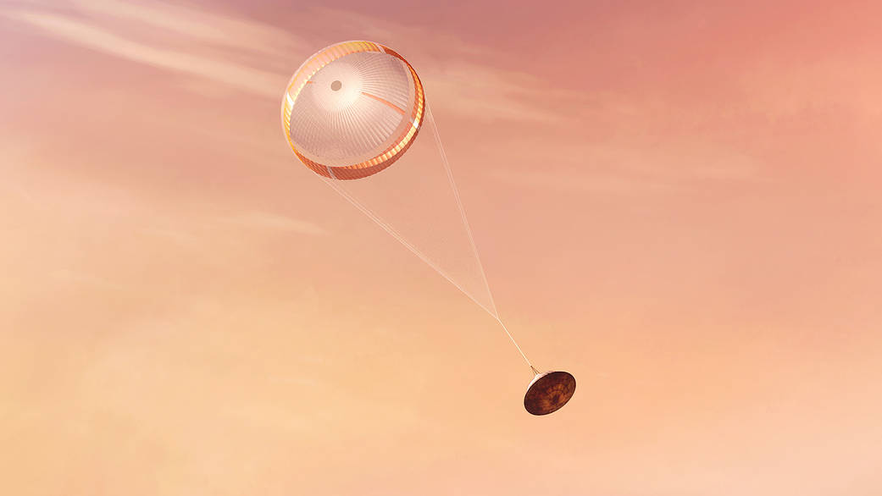
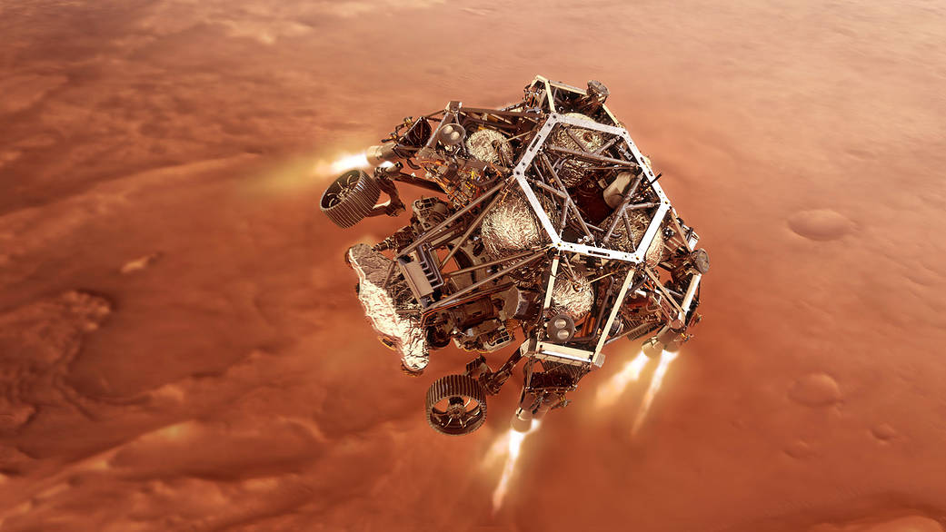
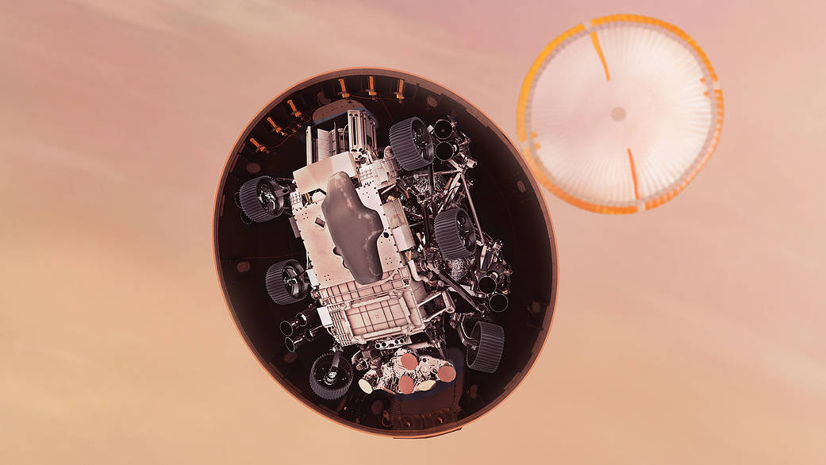
Perseverance

Slide 14
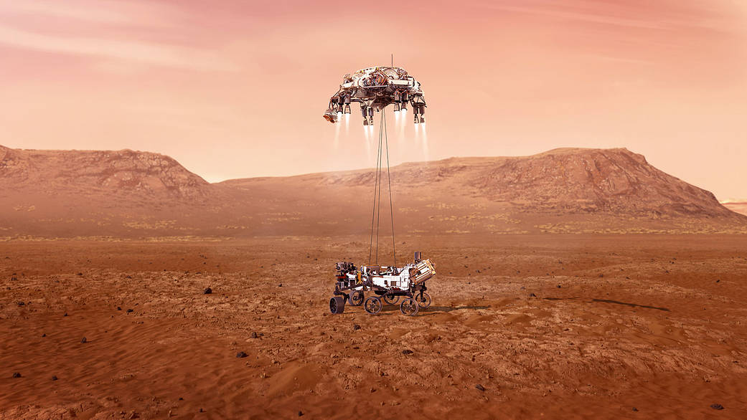

Slide 15
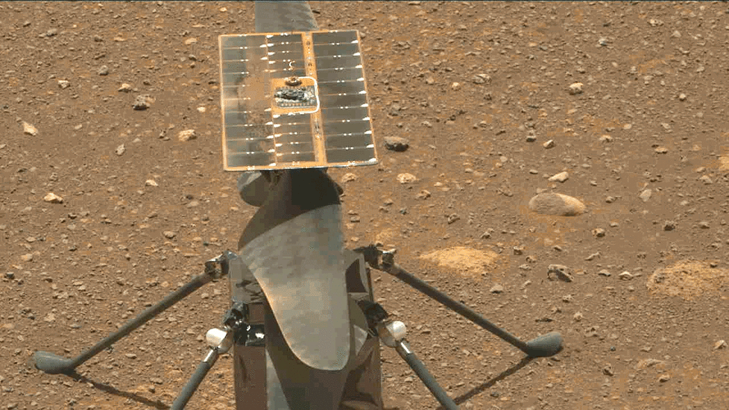
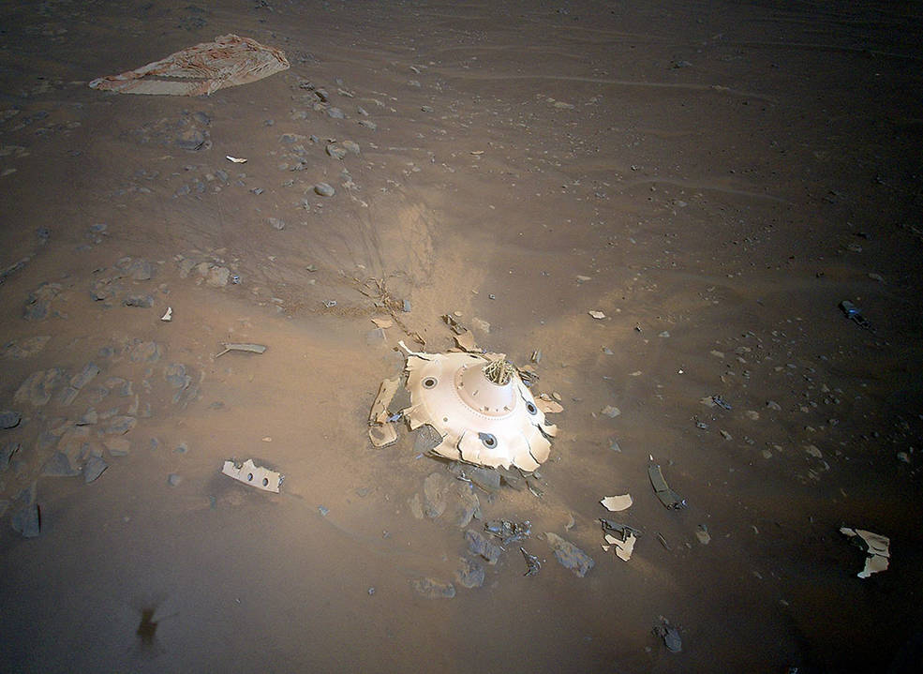
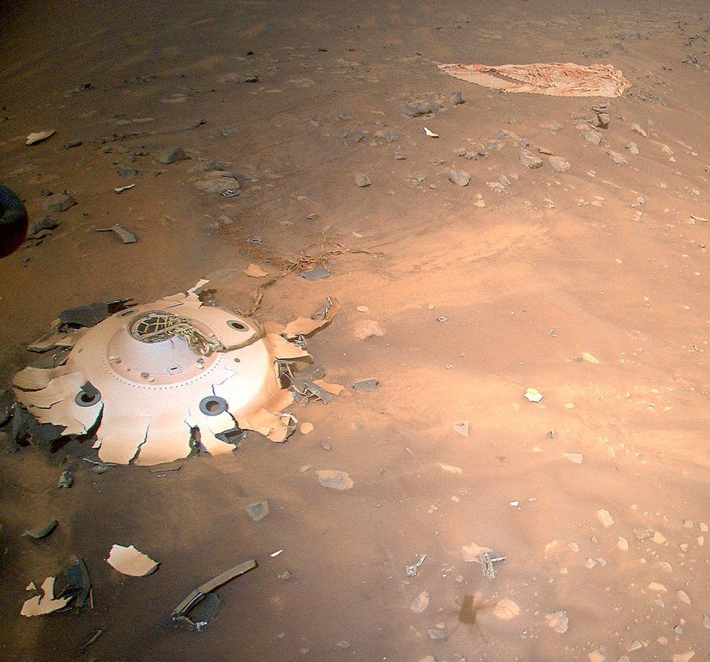
Ingenuity

Slide 16
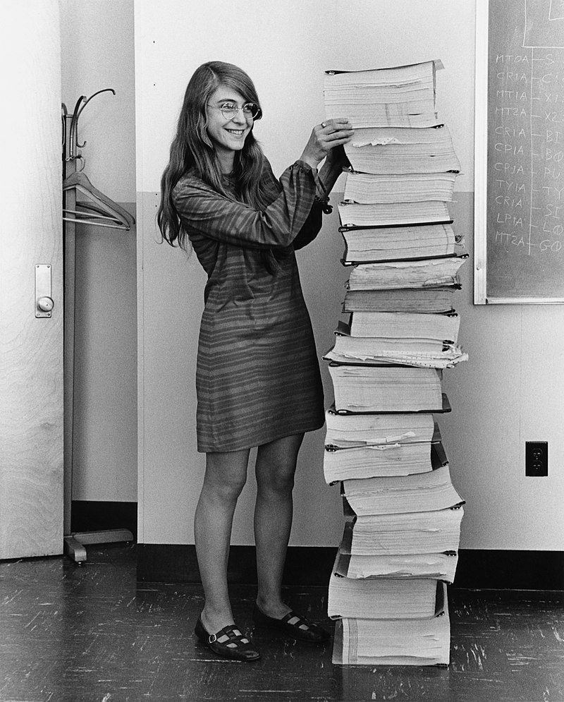
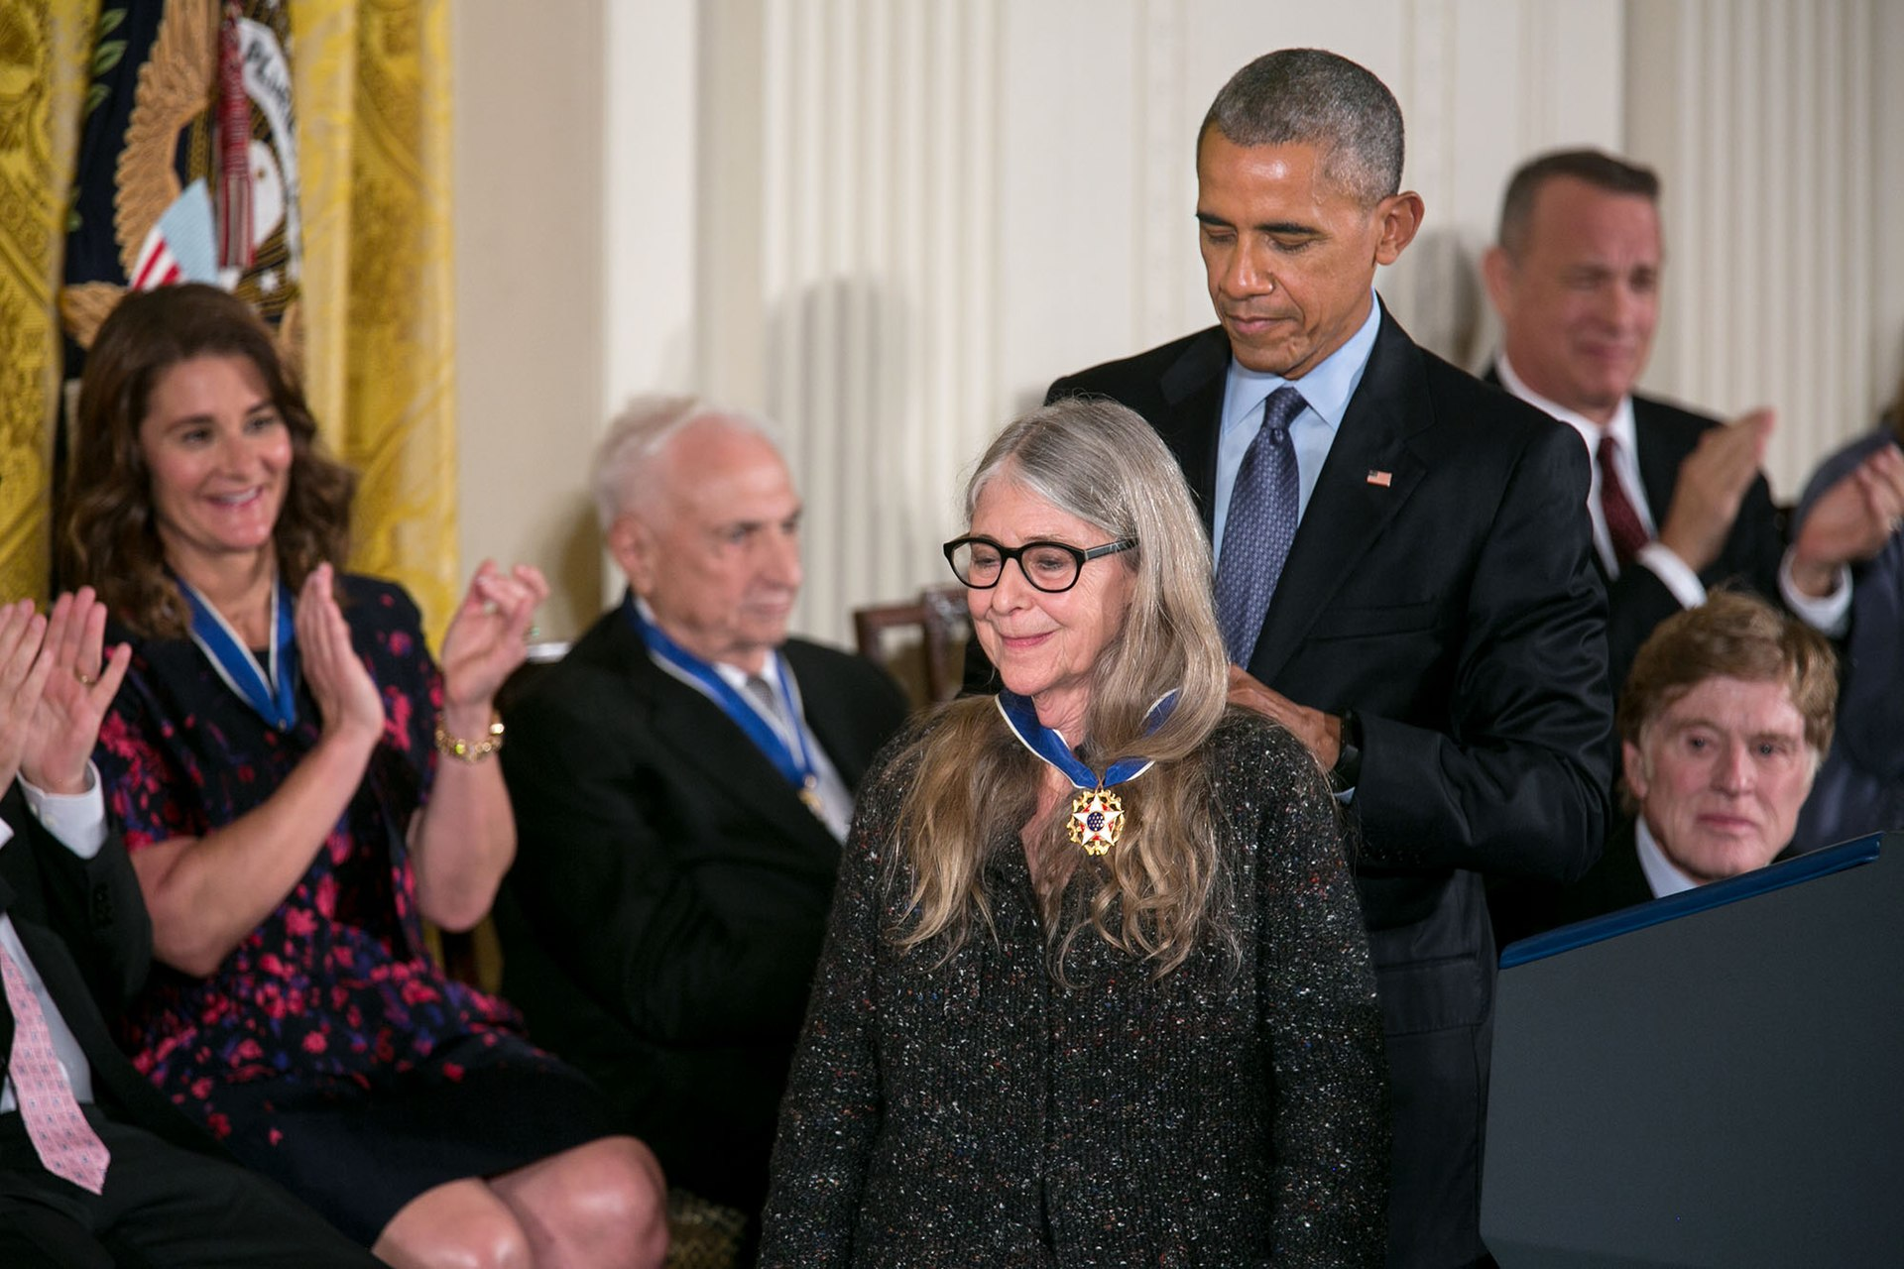

Slide 17
Thank you for your attention!

